Slide 1

Jingwei Wu, PhD
Chapter 13
The Pearson Correlation Coefficient
A courtesy of “USING AND INTERPRETING STATISTICS” by ERIC W. CORTY | THIRD EDITION (Macmillan Education)

Slide 2

Objectives
Introduction to the Pearson Correlation Coefficient
Calculating the Pearson Correlation Coefficient
Interpreting the Pearson Correlation Coefficient
Calculating a Partial Correlation

Slide 3
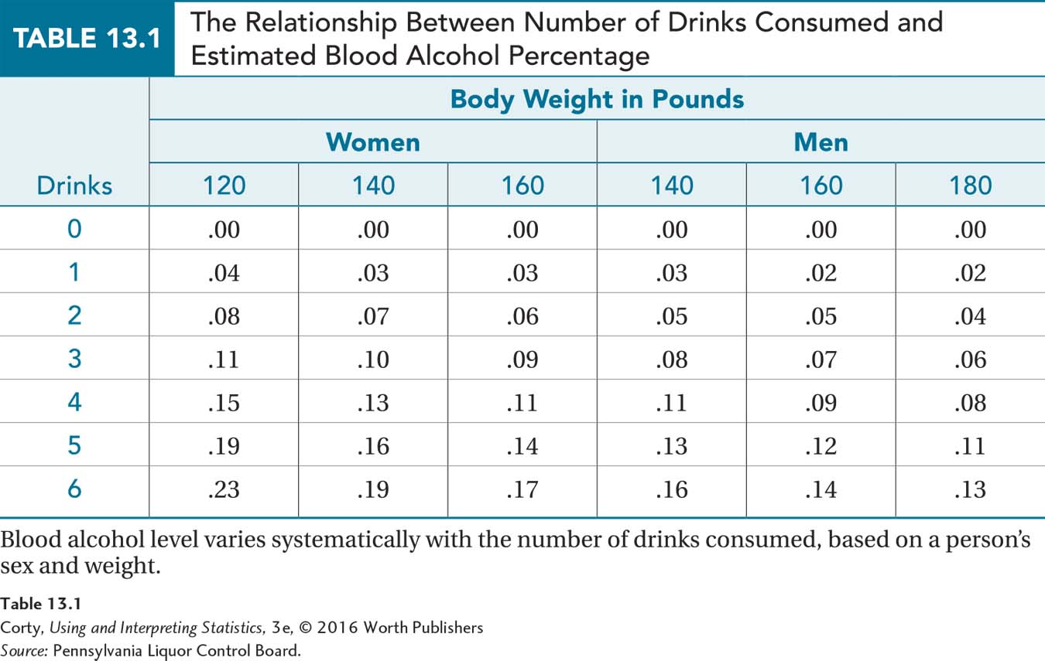
Defining Pearson r and Relationship
Pearson Correlation Coefficient
Statistical test that measures the degree of linear relationship between two interval/ratio-level variables
If two variables are related, they are said to be correlated
Example
Alcohol consumption and blood alcohol level
See Table 13.1

Slide 4
Correlation, Causation, and Association
CORRELATION IS NOT CAUSATION
Correlation between two variables only guarantees an association between the two variables: they systematically vary together.
Correlation most likely results because each is associated with a third variable.
Variables are in a relationship test not manipulated by the researcher
Variables are frequently called X and Y.
If there is a believed order to the relationship, then they are called:
Predictor Variable
Outcome Variable

Slide 5
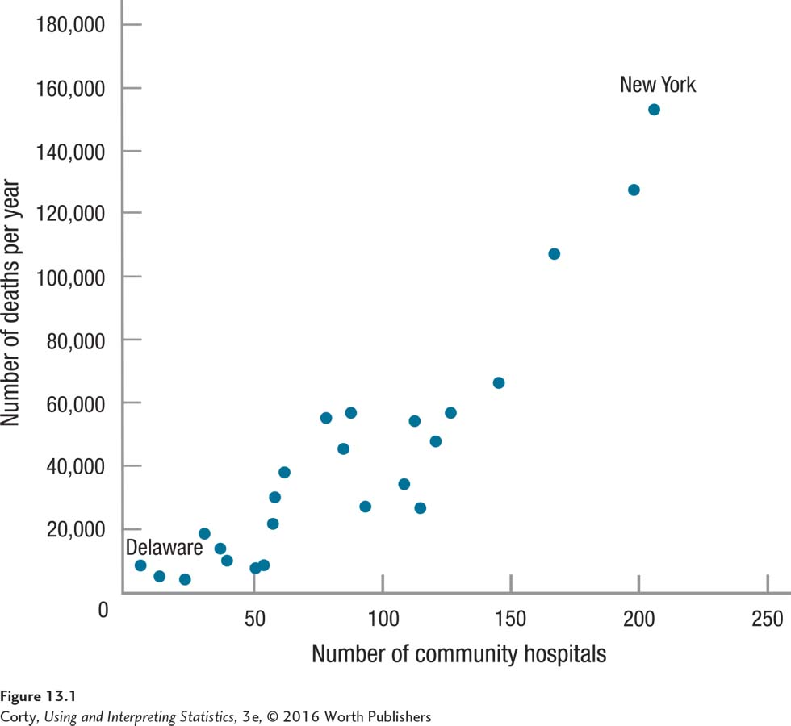
Correlation, Causation, and Association
Scatterplot
Type of graph that displays the relationship between two variables
This scatterplot illustrates the relationship between number of community hospitals per state and number of deaths per year in that state
States with more hospitals have more deaths
Relationship can be read in either direction
Correlation most likely due to each associated with third variable ̶ population
Relationship at a State Level Between Number of Community Hospitals and Number of Deaths
Each point represents a state on the two variables

Slide 6
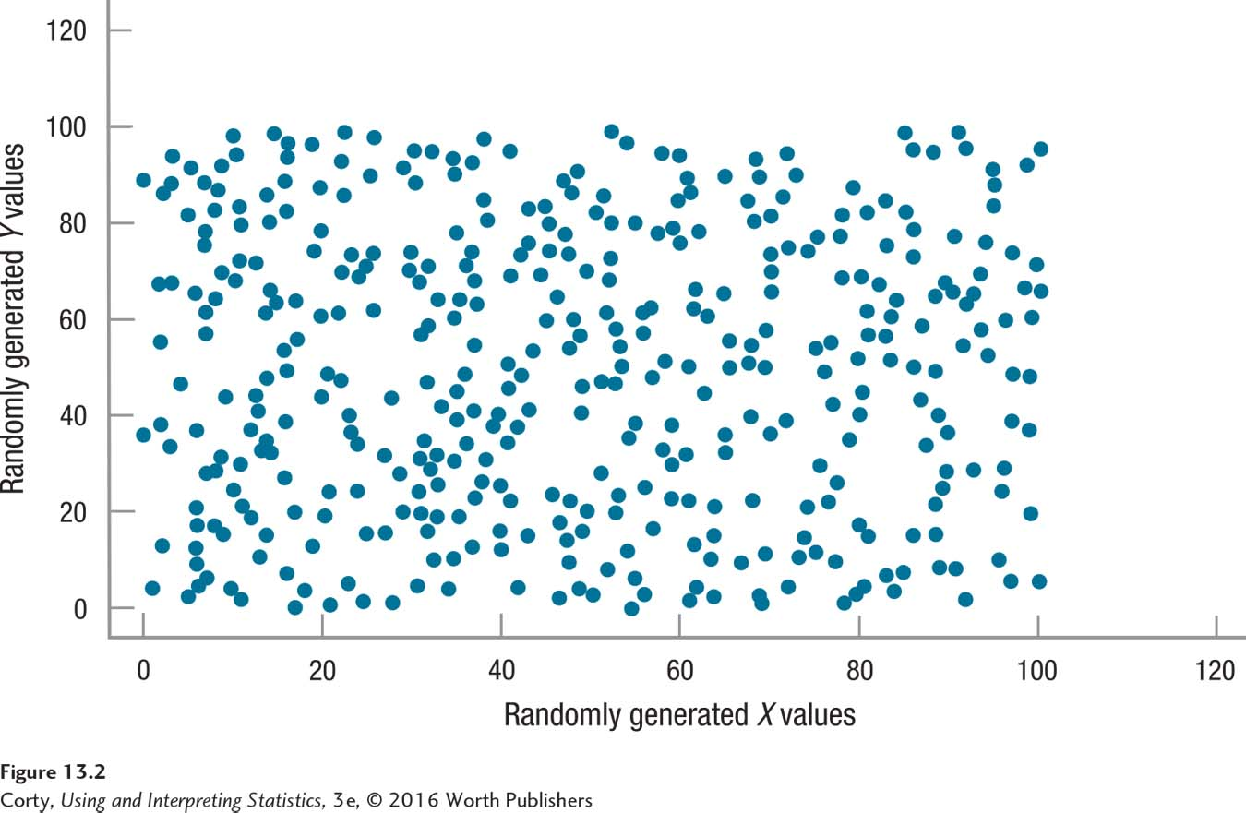
Visualizing Relationships
Degree to which two variables vary together determines whether the relationship is strong or weak
Strength of the relationship can be visualized in a scatterplot
Figure 13.2
Shows a scatterplot with no relationship
Zero correlation
Lack of Relationship Between Randomly Generated Values of X and Randomly Generated Values of Y

Slide 7
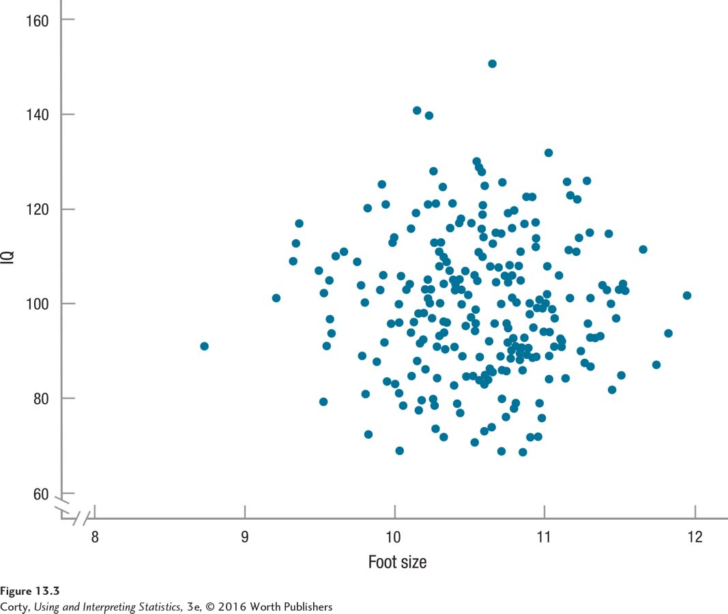
Visualizing Relationships
Statisticians commonly use a circular scatterplot to demonstrate no relationship between two variables.
If both variables are normally distributed (one of the assumptions for the Pearson r), then the scatterplot has a circular shape when no relationship exists.
Zero Correlation Between Two Normally Distributed Variables

Slide 8
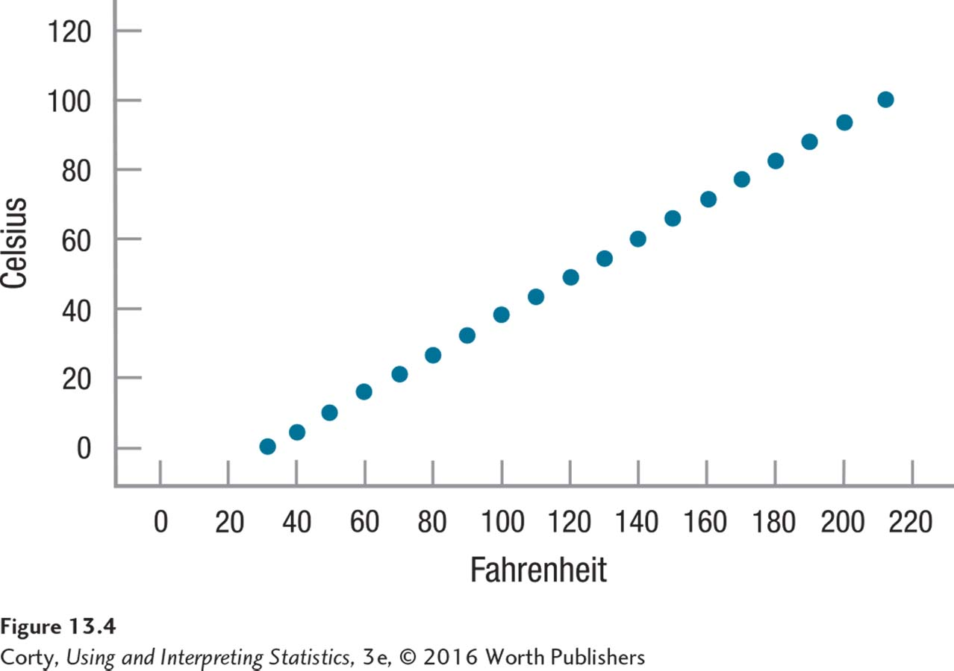
Visualizing Relationships
Perfect Relationship
Relationship between two variables is perfect if the value of one can be exactly predicted from the other.
All the data points fall along a straight line.
Figure 13.4
A perfect relationship
A Perfect Linear Relationship:
The relationship between temperature as measured in degrees Fahrenheit and degrees Celsius is a perfect one.

Slide 9
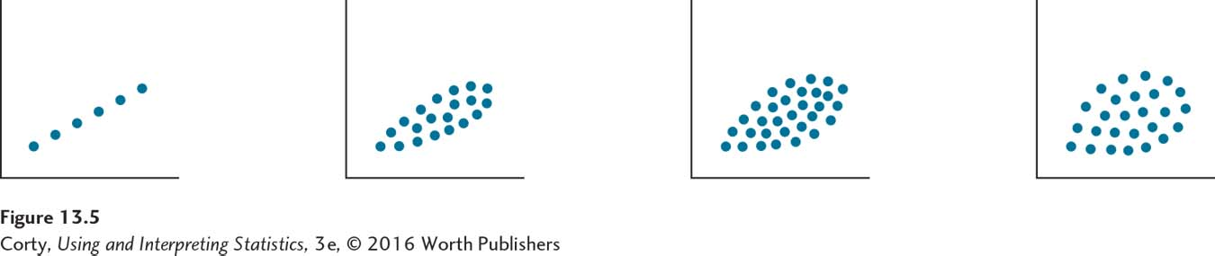
Strength of Relationships
Four scatterplots (A–D) differ in the degree to which the points form a straight line or are spread out to form an oval.
As the amount of spread increases (i.e., as the points fall less along a line), the relationship becomes weaker.
Visualizing the Strength of Relationships

Slide 10
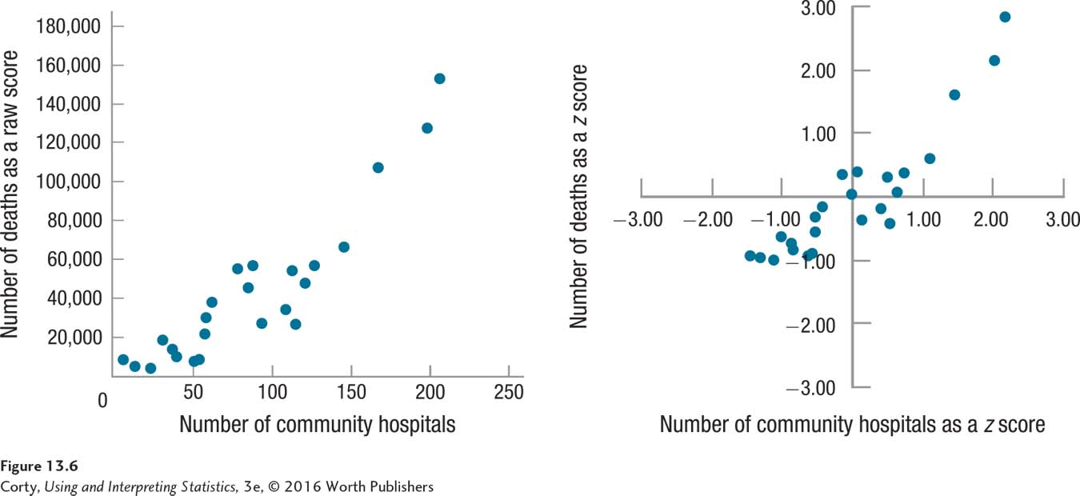
Correlations Defined by z Scores
Scatterplots can be drawn using z scores
Example: Number of Community Hospitals and Number of Deaths: Raw Scores and z Scores
When raw scores are transformed into z scores, the scales on the axes change, but the shape of the scatterplot does not change.
Dots form the same pattern in both of these scatterplots.

Slide 11
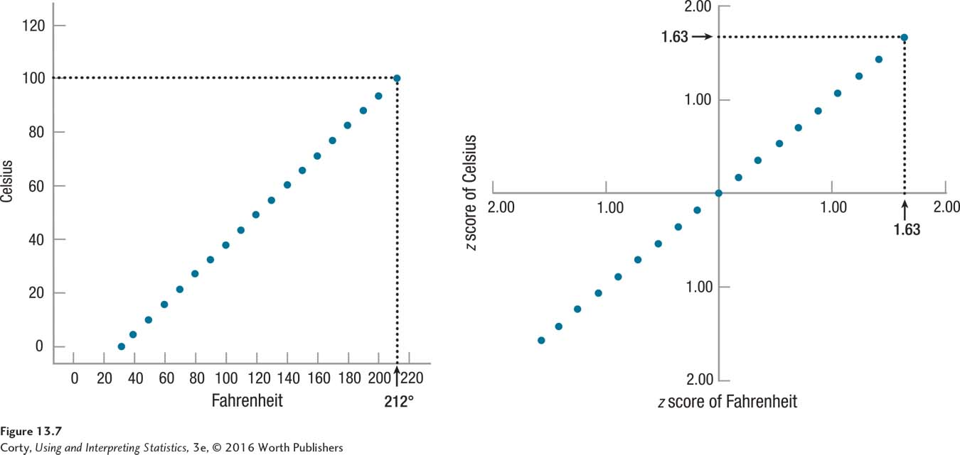
Correlations Defined by z Scores
Example: A Perfect Relationship: Raw Scores vs. z Scores
With a perfect relationship, a case’s z score on the X axis has exactly the same value as it does on the Y axis
Left panel: The data point for boiling water occurs at the intersection of 212°F and 100°C. Right panel: The data point is at the intersection of z scores of 1.63 on both axes.

Slide 12
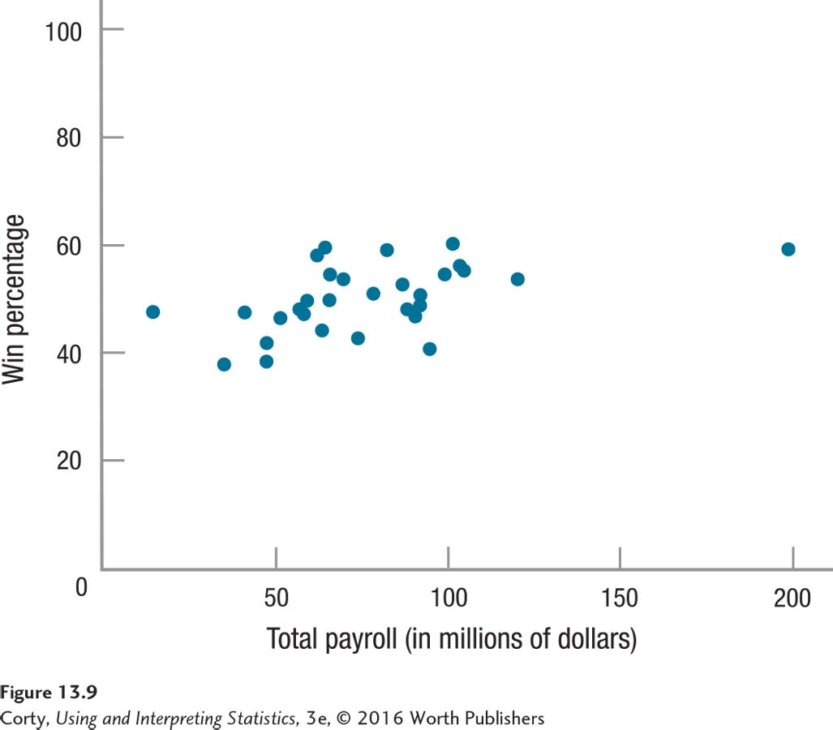
Quantifying Relationships
Example: Baseball
Scatterplot shows the relationship between the payrolls of Major League Baseball teams and their winning percentages
How strong is the association?
Scatterplot interpretation is subjective.
Correlation Coefficient
Statistic that summarizes, in a single number, the strength of a relationship between two variables

Slide 13
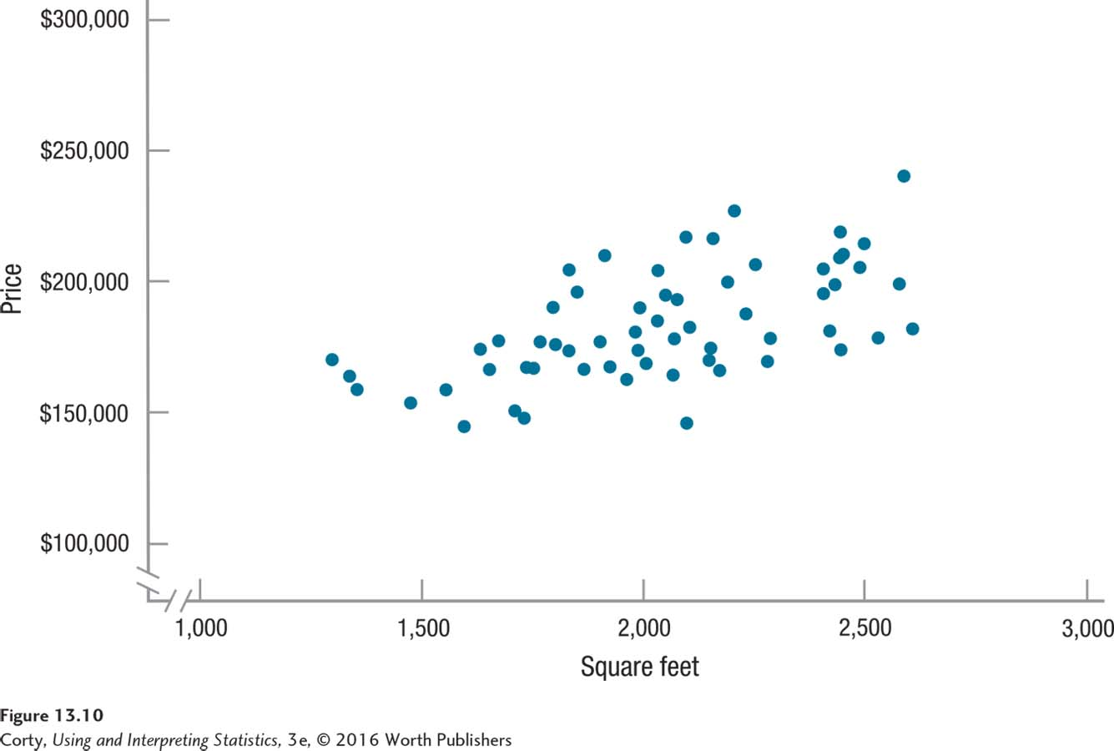
Direction of the Relationship
Positive Relationship
Relationship in which high scores on X are associated with high scores on Y
Called a direct relationship
Direct Relationship
Relationship in which high scores on X are associated with high scores on Y
Called a positive relationship
Positive Relationship Between the Size of a House and Its Cost
In a positive relationship, the data points in a scatterplot fall along a diagonal line that moves up and to the right. In this scatterplot, as the size of the house increases, the price generally does as well.

Slide 14
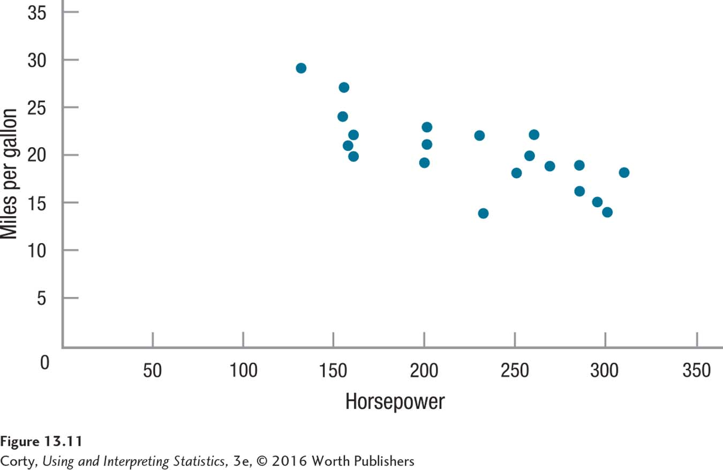
Direction of the Relationship
Negative relationship
Relationship in which high scores on X are associated with low scores on Y
Called an inverse relationship
Inverse Relationship
Relationship in which high scores on X are associated with low scores on Y
Called a negative relationship
Negative Relationship Between Horsepower and Fuel Economy In a negative relationship, points form a line moving downward and to the right. As one variable increases, the other decreases. Here, as the horsepower of cars goes up, miles per gallon go down.

Slide 15
Conditions Affecting Pearson r
Three conditions that affect Pearson r
Nonlinearity
See Figure 13.12
Outliers
See Figure 13.13
Restriction of range
See Figure 13.14 Let’s take a closer look at each of these conditions.

Slide 16
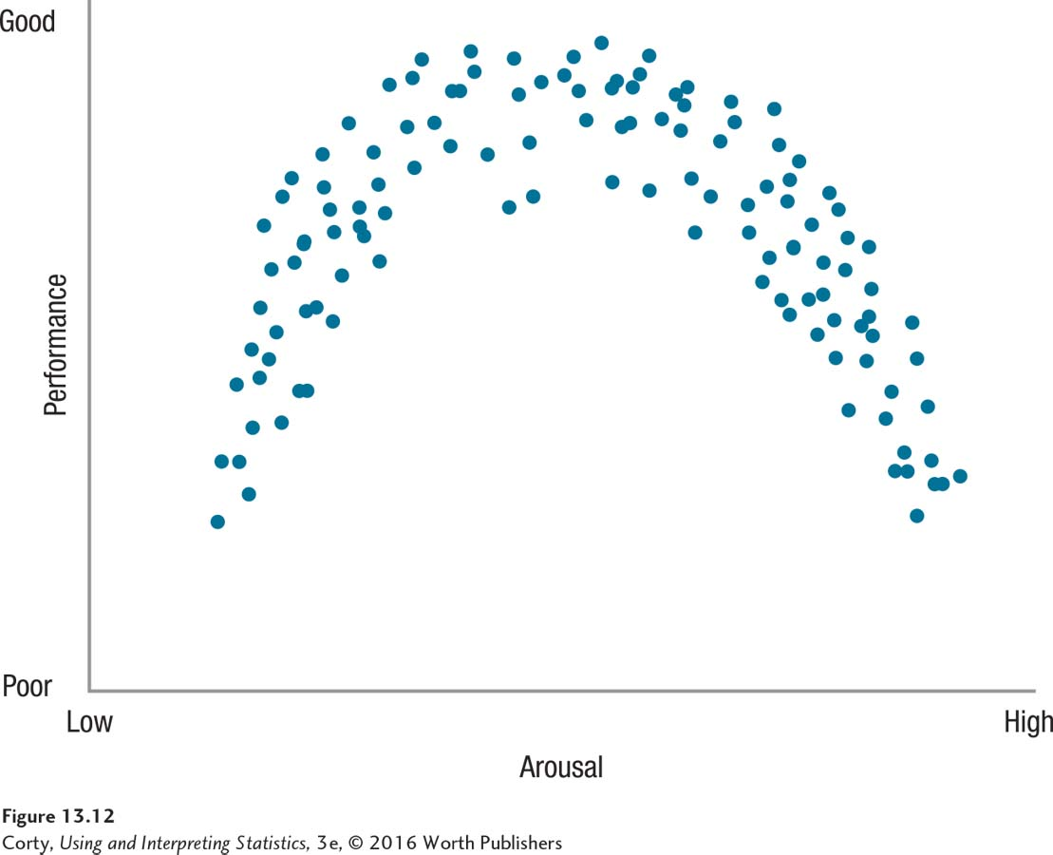
Conditions Affecting Pearson r
Nonlinearity
There is a relationship between X and Y in this scatterplot, but it is curvilinear, not linear.
Because the relationship is not a straight-line relationship, the Pearson r would be near zero.
An r of zero doesn’t mean there is no relationship; it just means that no linear relationship exists.
Example of a Curvilinear Relationship

Slide 17
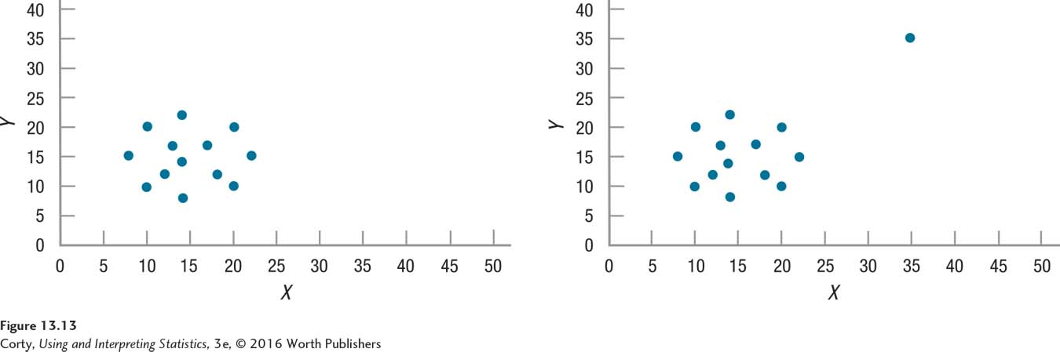
Conditions Affecting Pearson r
Outliers
Cases with extreme values; an outlier’s value falls far away from the values that other cases have.
One outlier in a data set can dramatically change the value of a correlation.
Effect of an Outlier on a Pearson Correlation
Panel A: Correlation in the scatterplot is zero.
Panel B: Correlation is .63 due to the addition of one case.
Additional case is an outlier, with extreme values on X and Y.

Slide 18
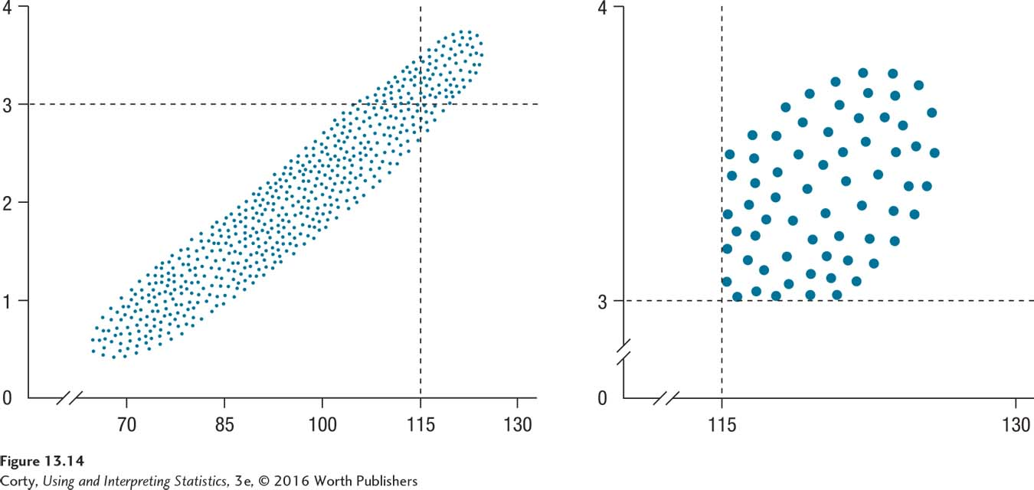
Conditions Affecting Pearson r
Restriction of Range
Deflates the value of a correlation
Effect of Restriction of Range on Correlation Coefficients
Left scatterplot shows the strong relationship between IQ and GPA for a large sample of high school students.
Right scatterplot depicts the relationship when the analysis is restricted to people with IQs of 115 or higher and GPAs of 3 or higher.

Slide 19
Calculating the Pearson r Correlation Coefficient
Example: Dr. Paik’s Gender Role Flexibility/ Marital Satisfaction Study
Does women’s marital satisfaction correlate with their husbands’ gender role flexibility?
Role Flexibility Test (RFT)
Scores ranged from 0 to 40
Higher scores = more role flexible
Completed by husbands
Marital Satisfaction
Calculated marital “GPA” ranged from 0 to 4; 0=F and 4=A
Completed by the women

Slide 20
Calculating the Pearson r Correlation Coefficient
Example: Data for Dr. Paik’s Study of the Relationship Between Gender Role Flexibility and Marital Satisfaction
Case | X Gender Role Flexibility | Y Marital Satisfaction
1. | 8 | .8
2. | 15 | 2.0
3. | 22 | 1.5
4. | 31 | 2.3
5. | 35 | 1.5
6. | 38 | 3.3
7. | 15 | 1.5
8. | 36 | 3.1
M= | 25.00 | 2.00
s= | 11.49 | 0.86

Slide 21
Hypothesis Testing in Action: Example
Example: Dr. Paik’s Marital Satisfaction Study
Six Steps of Hypothesis Testing
STEP 1: Pick a Test
STEP 2: Check the Assumptions
STEP 3: List the Hypotheses
STEP 4: Set the Decision Rule
STEP 5: Calculate the Test Statistic
STEP 6: Interpret the Results

Slide 22
Marital Satisfaction Study: Step 1
STEP 1: Pick a Test
Dr. Paik is examining the relationship between two interval-/ratio-level variables.
Dr. Paik will use a Pearson r.

Slide 23
Marital Satisfaction Study: Step 2
STEP 2: Check the Assumptions
The Pearson r has four assumptions that should be met in order to proceed with the test:
Random sample
Independence of observations
Normality
Linearity (new)

Slide 24
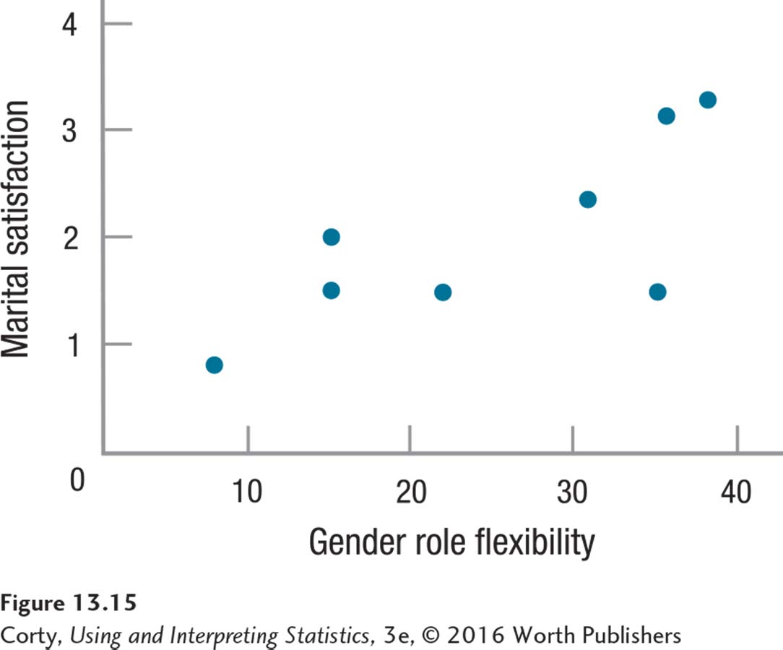
Marital Satisfaction Study: Step 2 (continued)
STEP 2: Check the Assumptions (continued)
Assumption 4: Linearity
Data points in this scatterplot for the most part fall along a straight line
Linearity assumption is not violated
No assumptions violated, so Dr. Paik can proceed to Step 3
Relationship Between Male Gender Role Flexibility and Female Marital Satisfaction

Slide 25
Marital Satisfaction Study: Step 3
STEP 3: List the Hypotheses
Null and alternative hypotheses are statements about populations, not samples
For the population value of a correlation, the Greek letter rho, ρ, will be used as the abbreviation
Nondirectional, Pearson r
H₀: ρ = 0
H₁: ρ ≠ 0

Slide 26
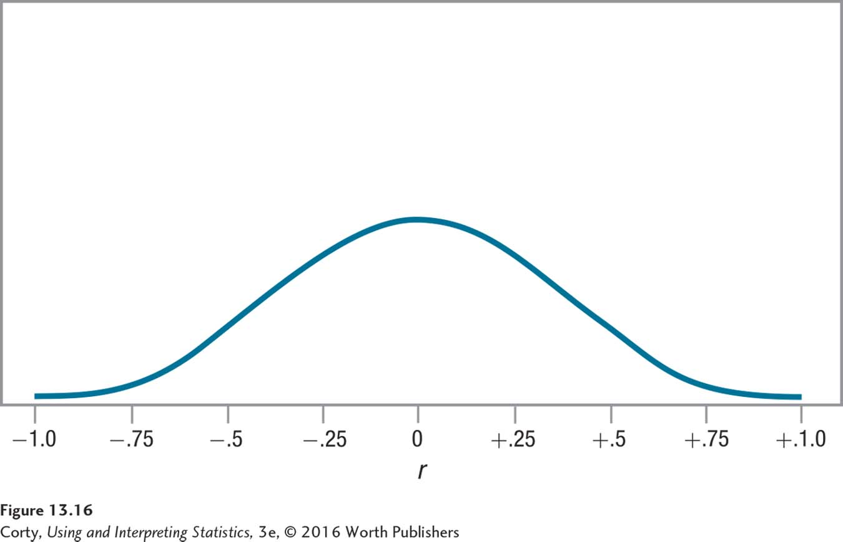
Marital Satisfaction Study: Step 4
STEP 4: Set the Decision Rule
Values range from −1.00 to 1.00
Centered at zero
Note that the frequencies decrease as r moves away from zero
r is symmetrical
Example of a Sampling Distribution of Pearson r

Slide 27
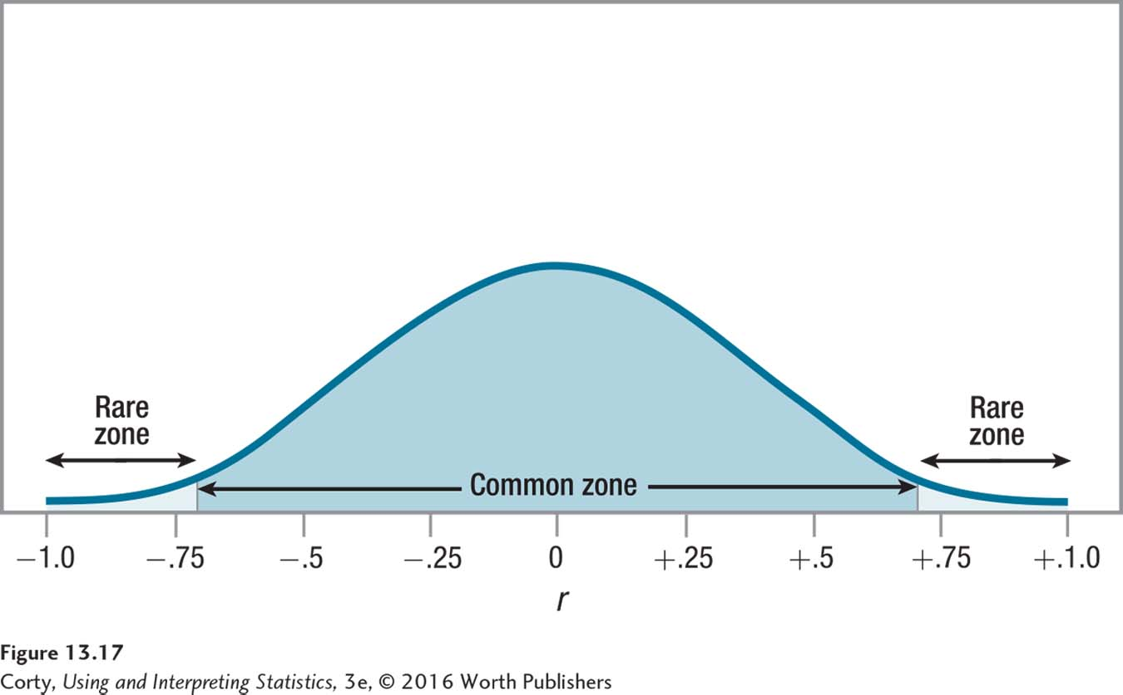
Marital Satisfaction Study: Step 4 (continued)
STEP 4: Set the Decision Rule (continued)
Two-tailed, alpha level, α = .05, df = 6, r_{cv} = ±.707
If r ≤ −.707 or r ≥ .707, reject H₀
If −.707 < r < .707, fail to reject H₀
Common Zone and Rare Zones for the Sampling Distribution of r for Dr. Paik’s Marital Satisfaction Study

Slide 28
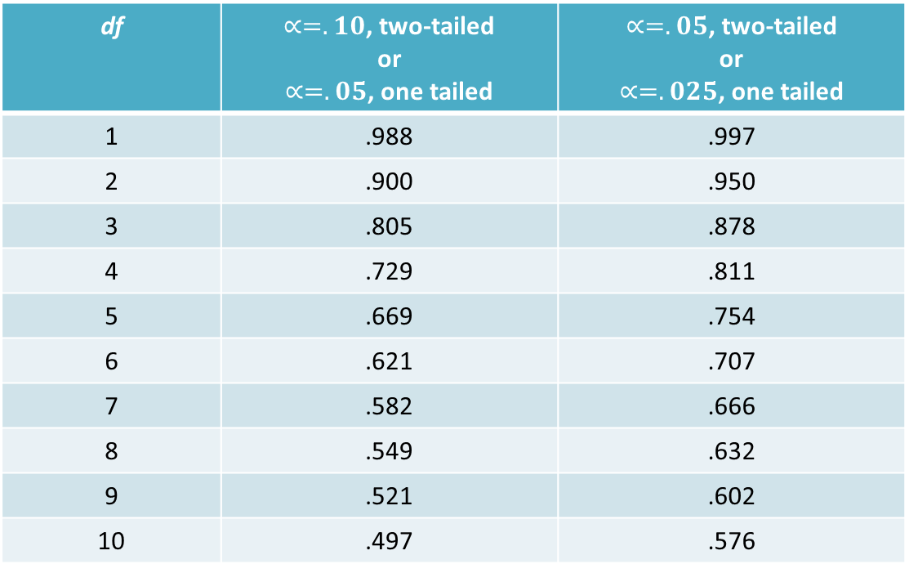
Marital Satisfaction Study: Step 4 (continued)
Section of Appendix Table 6, Table of Critical Values of r
df | $∝=.10$, two-tailed or $∝=.05$, one tailed | $∝=.05$, two-tailed or $∝=.025$, one tailed
1 | .988 | .997
2 | .900 | .950
3 | .805 | .878
4 | .729 | .811
5 | .669 | .754
6 | .621 | .707
7 | .582 | .666
8 | .549 | .632
9 | .521 | .602
10 | .497 | .576

Slide 29


Marital Satisfaction Study: Step 4 (continued)
Degrees of Freedom (df )
Calculate df ; Dr. Paik determines df = 6
$$df=N−2 \\ where df=degrees of freedom \\ N=number of cases in the sample$$
$$df=N−2 \\ =8−2 \\ =6$$

Slide 30
Marital Satisfaction Study: Step 4 (continued)
STEP 4: Set the Decision Rule (continued)
Two-tailed, alpha level, α = .05, df = 6, r_{cv} = ±.707
If r ≤ −.707 or r ≥ .707, reject H₀
If −.707 < r < .707, fail to reject H₀
Common Zone and Rare Zones for the Sampling Distribution of r for Dr. Paik’s Marital Satisfaction Study

Slide 31
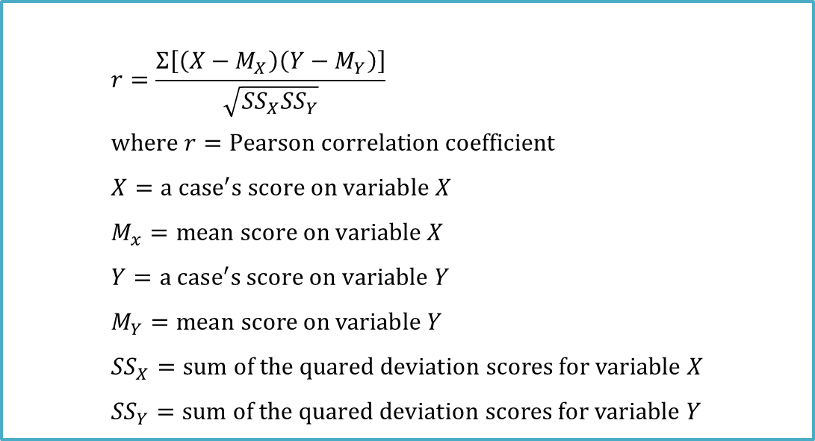
Marital Satisfaction Study: Step 5
STEP 5: Calculate the Test Statistic
Four steps in calculating the numerator
Six steps in calculating the denominator
$$r=\frac{Σ\left[\left(X−M_{X}\right)\left(Y−M_{Y}\right)\right]}{\sqrt{{SS}_{X}{SS}_{Y}}} \\ where r=Pearson correlation coefficient \\ X=a case^{′}s score on variable X \\ M_{x}=mean score on variable X \\ Y=a case^{′}s score on variable Y \\ M_{Y}=mean score on variable Y \\ {SS}_{X}=sum of the quared deviation scores for variable X \\ {SS}_{Y}=sum of the quared deviation scores for variable Y$$

Slide 32
Marital Satisfaction Study: Step 5 (continued)
Numerator: 4 steps
Take each X score and subtract the mean of the X scores from it. The resulting values are the X deviation scores.
Take each Y score and subtract the mean of the Y scores from it. The resulting values are the Y deviation scores.
For each case, multiply the two deviation scores together.
Add up all the multiplied pairs of deviation scores. This sum is the numerator in Equation 13.2.

Slide 33
Marital Satisfaction Study: Step 5 (continued)
Denominator: 6 steps
Take each X deviation score and square it.
Add up all the squared X deviation scores, to get the sum of squares for X, abbreviated SS_{X}.
Take each Y deviation score and square it.
Add up all the squared Y deviation scores, to get the sum of squares for Y, abbreviated as SS_{Y}.
Multiply SS_{X} from Step 2 by the SS_{Y} from Step 4.
The square root of the product found in Step 5 is the denominator in Equation 13.2.
Final Calculations
Take the numerator and divide it by the denominator, yielding the r value.

Slide 34
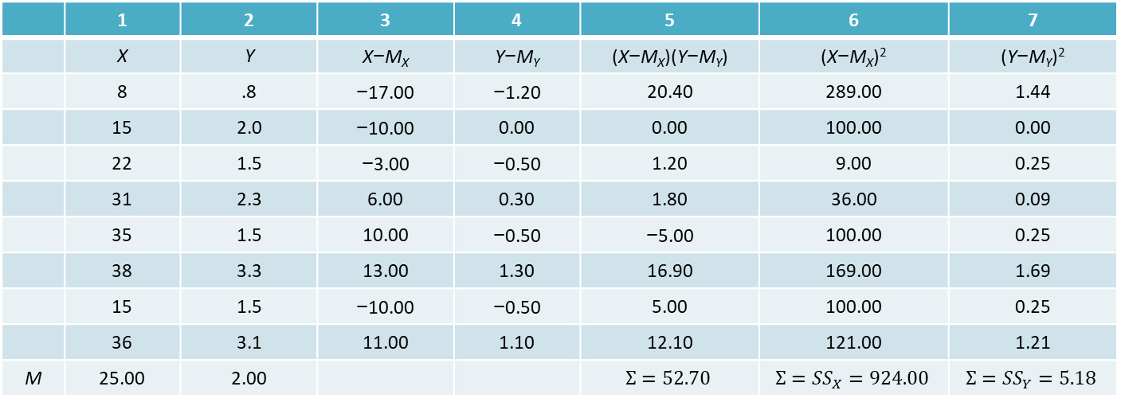
Marital Satisfaction Study: Step 5 (continued)
STEP 5: Calculate the Test Statistic
 | 1 | 2 | 3 | 4 | 5 | 6 | 7
 | X | Y | X−M_{X} | Y−M_{Y} | (X−M_{X})(Y−M_{Y}) | (X−M_{X})² | (Y−M_{Y})²
 | 8 | .8 | −17.00 | −1.20 | 20.40 | 289.00 | 1.44
 | 15 | 2.0 | −10.00 | 0.00 | 0.00 | 100.00 | 0.00
 | 22 | 1.5 | −3.00 | −0.50 | 1.20 | 9.00 | 0.25
 | 31 | 2.3 | 6.00 | 0.30 | 1.80 | 36.00 | 0.09
 | 35 | 1.5 | 10.00 | −0.50 | −5.00 | 100.00 | 0.25
 | 38 | 3.3 | 13.00 | 1.30 | 16.90 | 169.00 | 1.69
 | 15 | 1.5 | −10.00 | −0.50 | 5.00 | 100.00 | 0.25
 | 36 | 3.1 | 11.00 | 1.10 | 12.10 | 121.00 | 1.21
M | 25.00 | 2.00 |  |  | $$Σ=52.70$$ | $$Σ={SS}_{X}=924.00$$ | $$Σ={SS}_{Y}=5.18$$

Slide 35
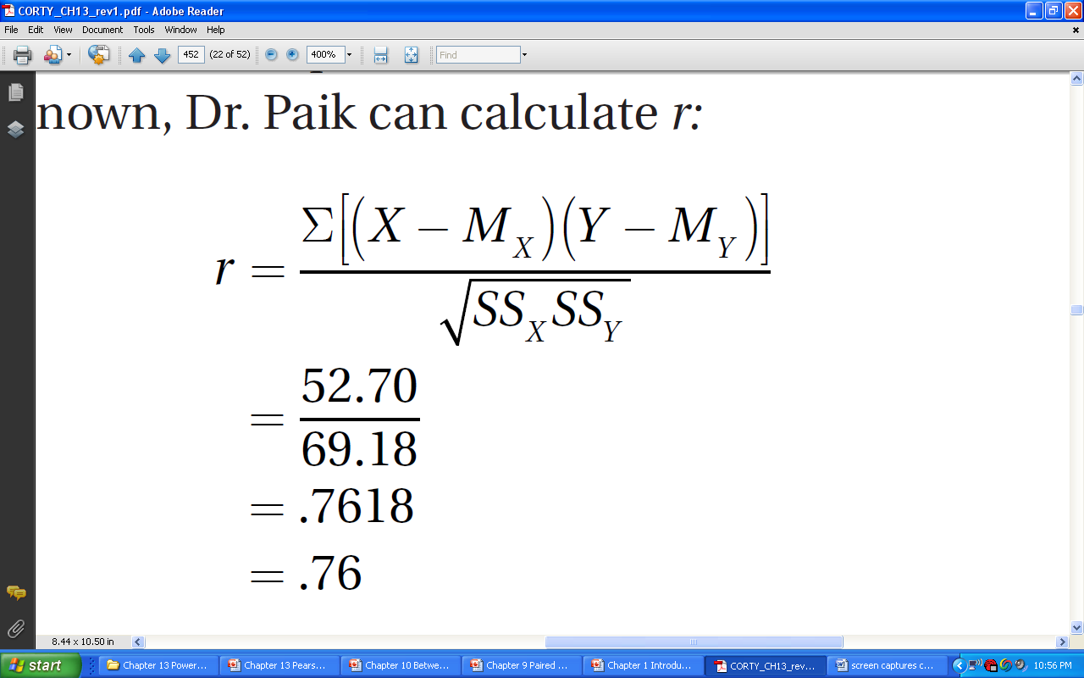
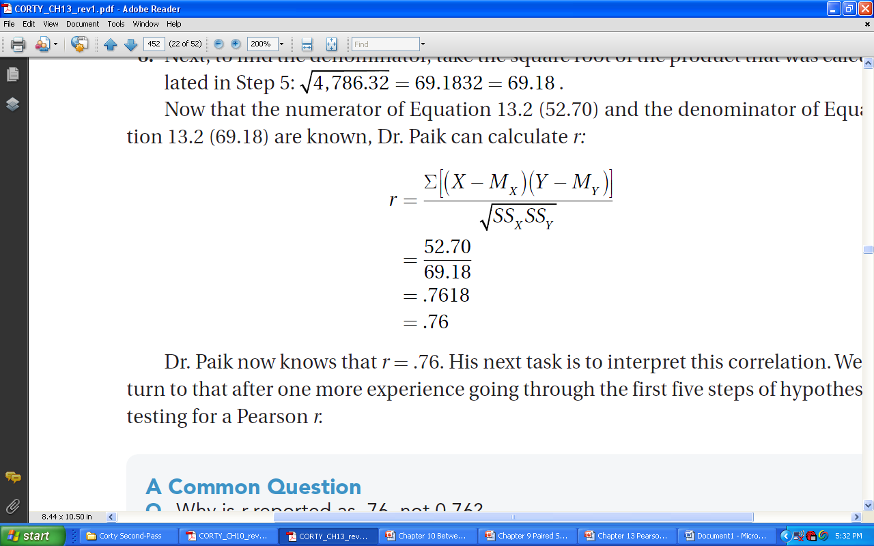
Marital Satisfaction Study: Step 5 (continued)
Numerator calculated in Table 13.4
Σ [(X – M_{X}) (Y – M_{Y})]
= 52.70
Denominator partially calculated in Table 13.4
SS_{X} = 924.00
SS_{Y} = 5.18
924.00 x 5.18 = 4,786.32
= 69.1832 = 69.18
r = .76

Slide 36
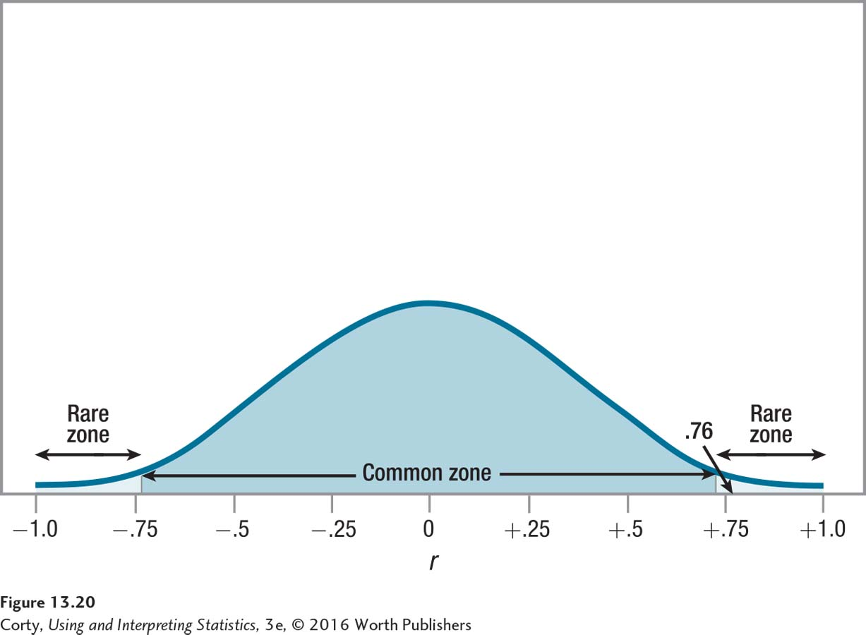
Marital Satisfaction Study: Step 6
STEP 6: Interpret the Results
Three questions
Was the null hypothesis rejected?
How big is the effect?
How wide is the confidence interval?
Implementing the Decision Rule for Dr. Paik’s Marital Satisfaction Study

Slide 37
Marital Satisfaction Study: Step 6 (continued)
STEP 6: Interpret the Results (continued)
Does women’s marital satisfaction correlate with how gender role flexible their husbands are?
r_{cv} = ± .707, r = .76
Reject the null hypothesis; see figure at right.
Implementing the Decision Rule for Dr. Paik’s Marital Satisfaction Study

Slide 38
Marital Satisfaction Study: Step 6: APA Style
STEP 6: Interpret the Results (continued)
APA format, r(6) = .76, p < .05
r tells that the test was a Pearson r
6, degrees of freedom for the test df = N − 2
.76 is the value of test statistic found in the sample
.05 tells alpha was set at .05, 5% chance of making a Type 1 error
p < .05 results landed in the rare zone, null hypothesis is rejected

Slide 39
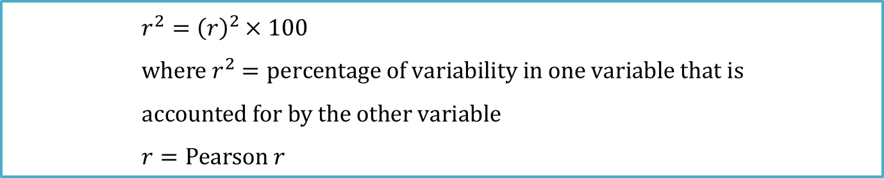
Marital Satisfaction Study: Step 6: Effect Size
STEP 6: Interpret the Results (continued)
How big is the effect?
Coefficient of Determination
Formal name for the effect size r²
r², pronounced “r squared”
Effect size that reveals the percentage of variability in one variable that is accounted for by the other variable
$$r^{2}={\left(r\right)}^{2}×100 \\ where r^{2}=percentage of variability in one variable that is \\ accounted for by the other variable \\ r=Pearson r$$

Slide 40
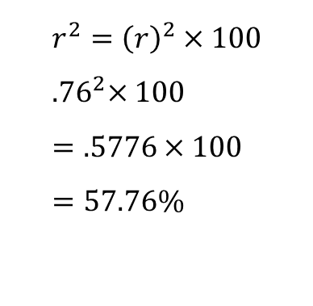
Marital Satisfaction Study: Step 6: Effect Size (continued)
Calculate effect size
Interpretation of r²
Small effect ≈ 1%
Medium effect ≈ 9%
Large effect ≈ 25%
$$r^{2}={\left(r\right)}^{2}×100 \\ {.76}^{2}×100 \\ =.5776×100 \\ =57.76\%$$

Slide 41
Marital Satisfaction Study: Step 6: Confidence Interval
STEP 6: Interpret the Results (continued)
Calculating 95% confidence interval for ρ, 95% CI_{ρ}, 3 steps:
Transform r value into a z_{r}
Called a Fisher’s r to z transformation
Use Appendix Table 7
Use z_{r} with Equations 13.4 and 13.5 to calculate confidence interval
Transform confidence interval from z_{r} units to r values Use Appendix Table 8

Slide 42
Marital Satisfaction Study: Step 6: Confidence Interval (continued)
Calculating 95% confidence interval for ρ, 95% CIρ, 3 steps:
STEP 1: Transform r value into a z_{r}
Rows represent the first digit of an r value
Columns represent the second digit of an r value
r value of .76 becomes a z_{r} of 1.00
Appendix Table 7: Transformation Table for Fisher’s r to z
 | .00 | .01 | .02 | .03 | .04 | .05 | .06 | .07 | .08 | .09
.0 | 0.00 | 0.01 | 0.02 | 0.03 | 0.04 | 0.05 | 0.06 | 0.07 | 0.08 | 0.09
.1 | 0.10 | 0.11 | 0.12 | 0.13 | 0.14 | 0.15 | 0.16 | 0.17 | 0.18 | 0.19
.2 | 0.20 | 0.21 | 0.22 | 0.23 | 0.24 | 0.26 | 0.27 | 0.28 | 0.29 | 0.30
.3 | 0.31 | 0.32 | 0.33 | 0.34 | 0.35 | 0.37 | 0.38 | 0.39 | 0.40 | 0.41
.4 | 0.42 | 0.44 | 0.45 | 0.46 | 0.47 | 0.48 | 0.50 | 0.51 | 0.52 | 0.54
.5 | 0.55 | 0.56 | 0.58 | 0.59 | 0.60 | 0.62 | 0.63 | 0.65 | 0.66 | 0.68
.6 | 0.69 | 0.71 | 0.73 | 0.74 | 0.76 | 0.78 | 0.79 | 0.81 | 0.83 | 0.85
.7 | 0.87 | 0.89 | 0.91 | 0.93 | 0.95 | 0.97 | 1.00 | 1.02 | 1.05 | 1.07
.8 | 1.10 | 1.13 | 1.16 | 1.19 | 1.22 | 1.26 | 1.29 | 1.33 | 1.38 | 1.42
.9 | 1.47 | 1.53 | 1.59 | 1.66 | 1.74 | 1.83 | 1.95 | 2.09 | 2.30 | 2.65

Slide 43
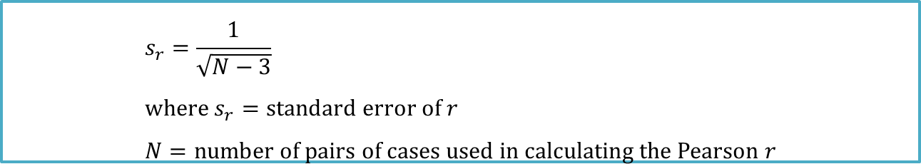
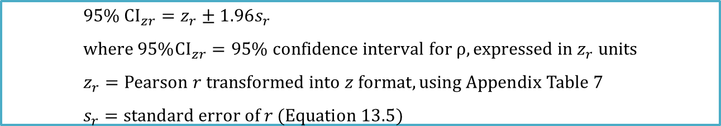
Marital Satisfaction Study: Step 6: Confidence Interval (continued)
Calculating 95% confidence interval for ρ, 95% CI_{ρ}, 3 steps:
STEP 2: Calculate the 95% confidence interval for the z value
$$95\% {CI}_{zr}=z_{r}±1.96s_{r} \\ where 95\%{CI}_{zr}=95\% confidence interval for ρ, expressed in z_{r} units \\ z_{r}=Pearson r transformed into z format, using Appendix Table 7 \\ s_{r}=standard error of r (Equation 13.5)$$
$$s_{r}=\frac{1}{\sqrt{N−3}} \\ where s_{r}=standard error of r \\ N=number of pairs of cases used in calculating the Pearson r$$

Slide 44
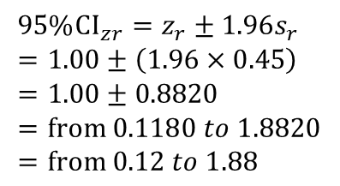
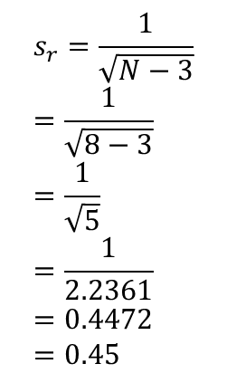
Marital Satisfaction Study: Step 6: Confidence Interval (continued)
$$s_{r}=\frac{1}{\sqrt{N−3}} \\ =\frac{1}{\sqrt{8−3}} \\ =\frac{1}{\sqrt{5}} \\ =\frac{1}{2.2361} \\ =0.4472 \\ =0.45$$
Calculating 95% confidence interval for ρ, 95% CIρ, 3 steps:
STEP 2: Calculate the 95% confidence interval for the z value
Formula, 1.96 standard errors of r, abbreviated s_{r}, added to and subtracted from z_{r}
Before calculating 95% CIρ, s_{r} needs to be calculated using Equation 13.5
$$95\%{CI}_{zr}=z_{r}±1.96s_{r} \\ =1.00±\left(1.96×0.45\right) \\ =1.00±0.8820 \\ =from 0.1180 to 1.8820 \\ =from 0.12 to 1.88$$

Slide 45
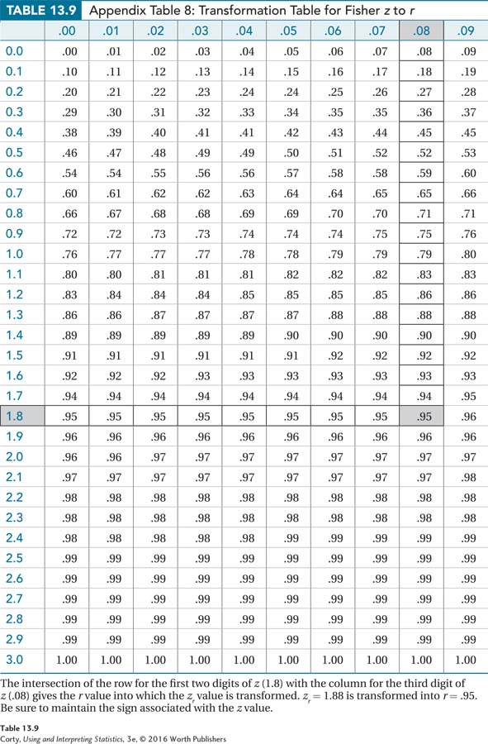
Marital Satisfaction Study: Step 6: Confidence Interval (continued)
Calculating 95% confidence interval for ρ, 95% CIρ, 3 steps:
STEP 3: Transform confidence interval from z_{r} units to r values Use Appendix Table 8
Each row covers the first decimal place of a z_{r} value
Each column is the second decimal place of a z_{r} value
At the intersection of the row and column, the z_{r} value is transformed back into an r value
Sign must be maintained
z_{r} = 1.88 transformed into r = .95
z_{r} = .12 transformed into r = .12

Slide 46
Marital Satisfaction Study: Step 6: Confidence Interval (continued)
STEP 6: Interpret the Results (continued)
95% confidence interval for ρ
r = .12 to r = .95
Dr. Paik is bothered by the width of the confidence interval: it ranges from near 0 (.12) to near 1 (.95).
The reason the confidence interval is so wide is that the sample size was small.

Slide 47
Marital Satisfaction Study: Putting It All Together
Points addressed in Dr. Paik’s interpretation
What was the study about?
What were its main results?
What do these results mean?
Are there specific suggestions for future research?

Slide 48
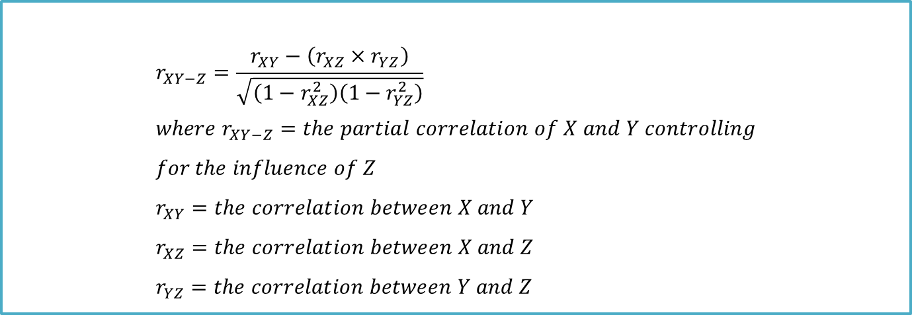
Partial Correlation
A partial correlation mathematically removes the influence of a third variable on a correlation.
$$r_{XY−Z}=\frac{r_{XY}−\left(r_{XZ}{×r}_{YZ}\right)}{\sqrt{\left(1−r_{XZ}^{2}\right)\left(1−r_{YZ}^{2}\right)}} \\ where r_{XY−Z}=the partial correlation of X and Y controlling \\ for the influence of Z \\ r_{XY}=the correlation between X and Y \\ r_{XZ}=the correlation between X and Z \\ r_{YZ}=the correlation between Y and Z$$

Slide 49
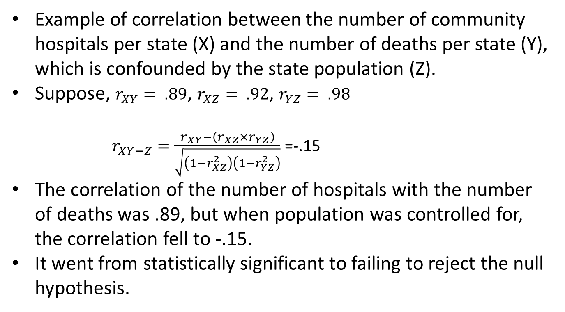
Partial Correlation Calculation Example
Example of correlation between the number of community hospitals per state (X) and the number of deaths per state (Y), which is confounded by the state population (Z).
Suppose, $r_{XY}= .89$, $r_{XZ}= .92$, $r_{YZ}= .98$
$r_{XY−Z}=\frac{r_{XY}−\left(r_{XZ}×r_{YZ}\right)}{\sqrt{\left(1−r_{XZ}^{2}\right)\left(1−r_{YZ}^{2}\right)}}$ =-.15
The correlation of the number of hospitals with the number of deaths was .89, but when population was controlled for, the correlation fell to -.15.
It went from statistically significant to failing to reject the null hypothesis.

